Slide 1
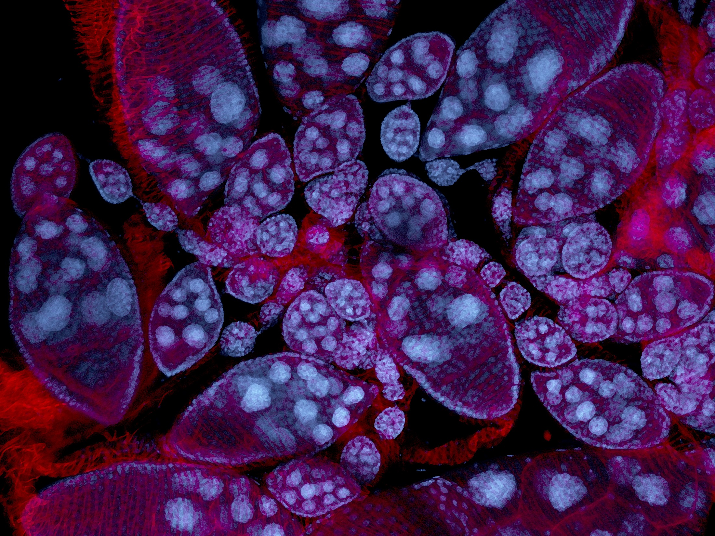
Protrusions driving border cell migration
Gregory Emery – IRIC – Université de Montréal

Slide 2
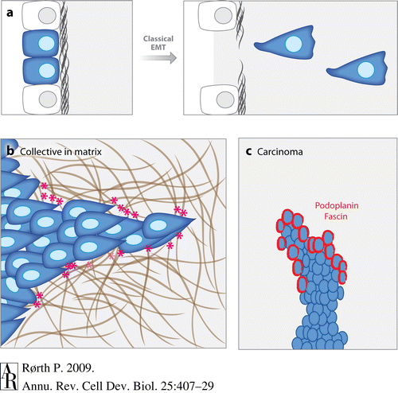
Collective Cell Migration
Morphogenesis
Wound healing
Metastasis !

Slide 3
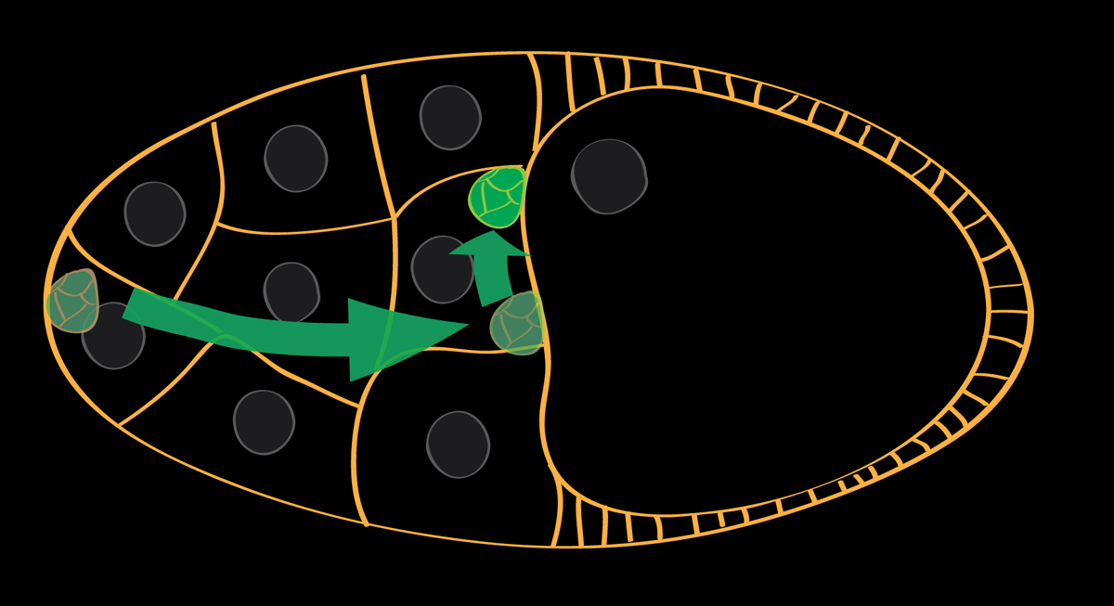
Border Cell Migration
1) 6-8 cells detaches from the epithelium (EMT)
2) the cluster is attracted by ligands of Receptor Tyrosine Kinases
3) Invasive migration toward the nucleus of the oocyte
4) Homing of the cluster

Slide 4
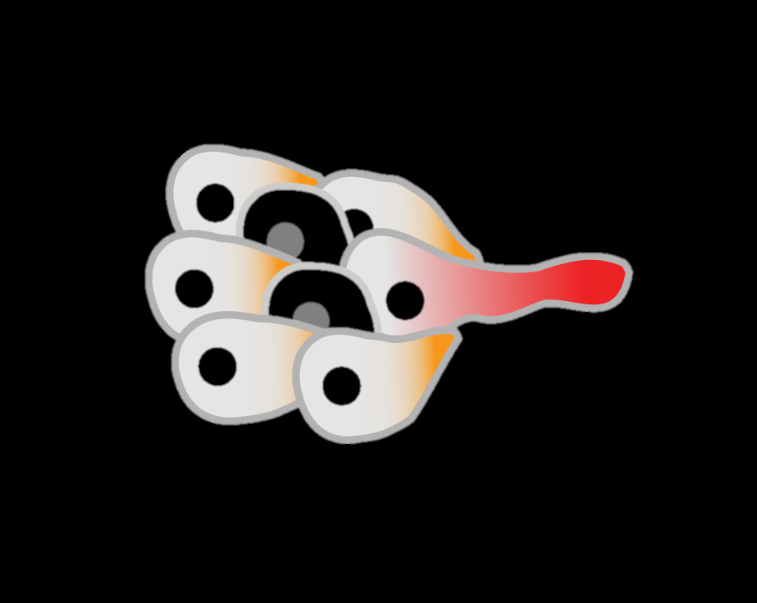
The Border Cell Cluster
Polarisation :
RTK (EGF-R, PVR)
Rac
Actin protrusions

Slide 5
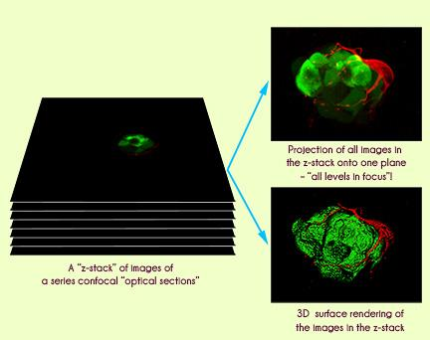
3D image acquisition
Illustration:Peter Ekström

Slide 6
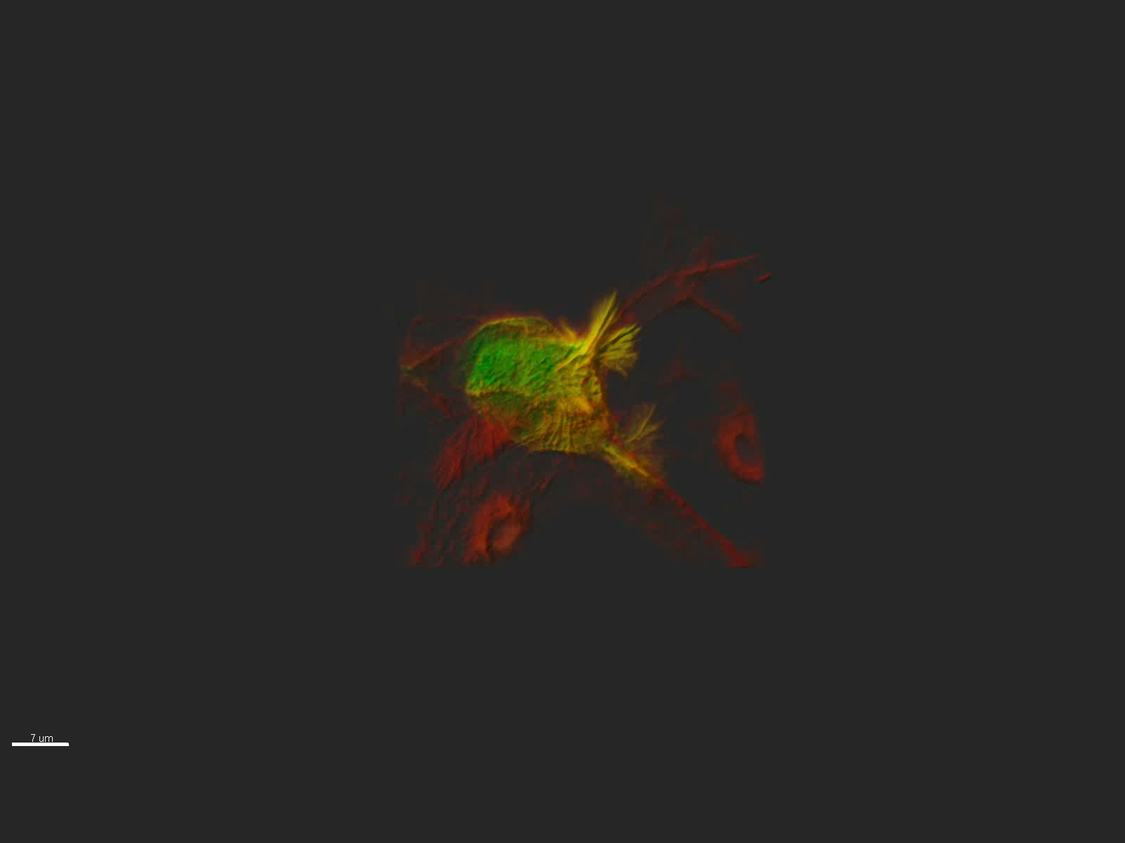
Protrusions are actin based structures

Slide 7
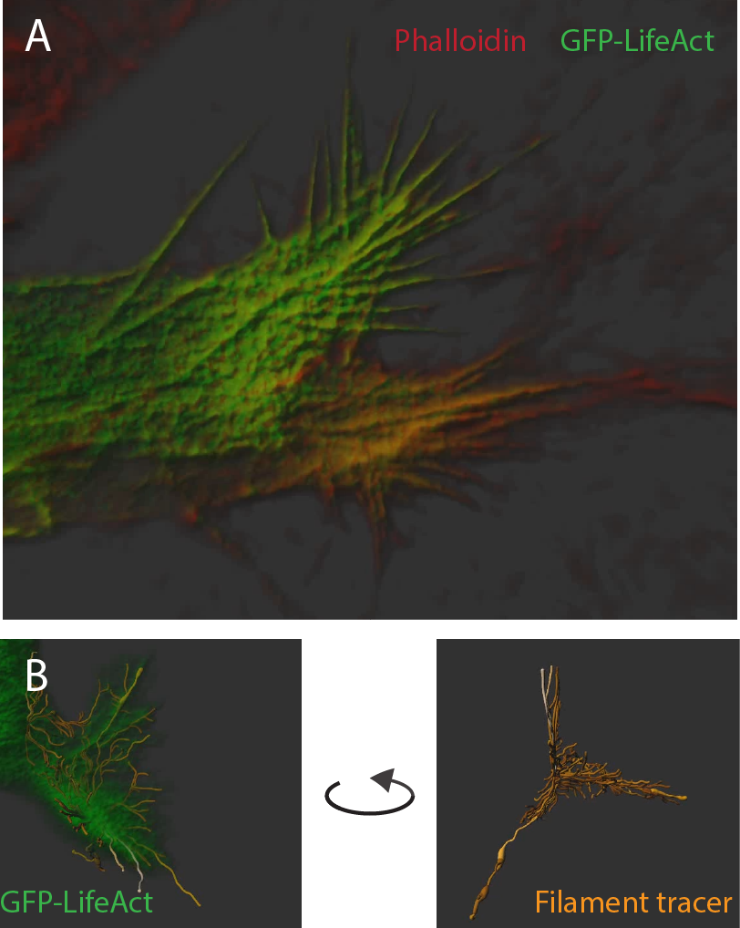
Goal: Characterize actin in protrusions
Segment actin structures and extract geometrical parameters:
-Length
-Volume
-Angles between filaments
-Density
-etc

Slide 8
If 3D is too complicated…

Slide 9
Material provided
Illustration:Peter Ekström
Image files:
-czi file (Zeiss proprietary file, use Zen from Zeiss or ImageJ/Fiji)
-individual (16 bits) and merged channels (8 bits) tiff files for each plans of the z-scan (green is GFP-lifeact, red is phalloidin)
-dimensions (Word file)

Slide 10
Dimensions
Pixel size: 0.04 um x 0.04 um
Distance between frames: 0.185 um
Z-stacks: 109 slices, 19.976 um
Image size: 44.98 um x 44.98 um, 1120 px x 1120 px
Bit Depth: 16 (except merged images: 8)

Slide 11
Have fun !!! ☺
gregory.emery@umontreal.ca

